Slide 2
Lesson 3: Object Oriented Design (10hrs)
Writing contracts: Describing and Elaborating Use Cases
Collaboration Diagram and Sequence Diagram
Objects and Patterns (information expert, creator, low coupling, high cohesion, controller)
Determining Visibility
Class Diagram

Slide 3
Class Diagram
A class diagram describes the static structure of a system.
They are used for static object modelling.
It shows how a system is structured rather than how it behaves.
Class diagrams illustrates classes, interfaces, and their associations.
The static structure of a system comprises of several class diagrams and their dependencies.
Class Diagrams are created in parallel with Interaction Diagram.
A common modelling term for this purpose is Design Class Diagram (DCD).

Slide 4
Design Class Diagram
Typical information includes:
Classes, Associations and Attributes with type information
Interfaces, with their operations and constants
Methods
Navigability
Dependencies
Conceptual classes in the Domain Model show real-world concepts, where as Design classes in the DCDs show definitions for software classes.
During analysis -> emphasize domain concepts.
During design -> shift to software artifacts.

Slide 5
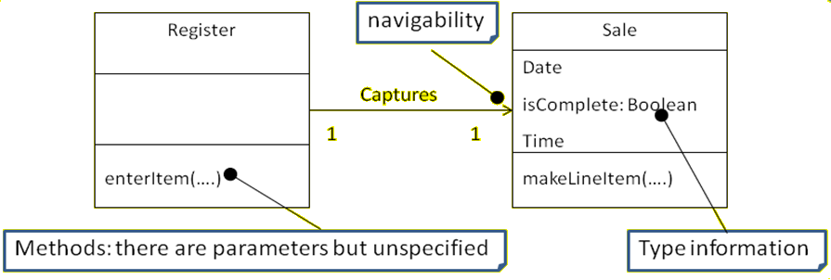
Design Class Diagram

Slide 6
Making Design Class Diagram
Identify all the classes participating in the software solution. This should be done by analyzing the interaction diagram.
Draw them in a class diagram
Duplicate the attributes from the associated concepts in the conceptual model
Add methods names by analyzing the interaction diagrams
Add type information to the attributes and methods
Add the associations necessary to support the required attribute visibility
Add navigability arrow to the association to indicate direction of attribute visibility
Add dependency relationship line to indicate non-attribute visibility

Slide 7
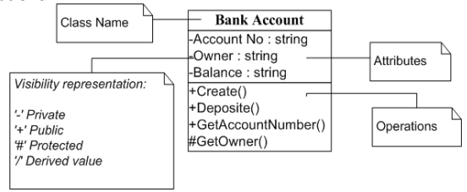
Design Class Diagram
Attributes – Structural features
Operations – Behavioral features

Slide 8
Design Class Diagram
A class notation consists of three parts:
Class Name: The name of the class appears in the first partition.
Class Attributes: Attributes are shown in the second partition.
The attribute type is shown after the colon.
Attributes map onto member variables (data members) in code.
Class Operations or Methods: Operations are shown in the third partition.
They are services the class provides.
The return type of a method is shown after the colon at the end of the method signature.
The return type of method parameters is shown after the colon following the parameter name.
Operations map onto class methods in code.

Slide 9
Design Class Diagram
The bottom most section of a Class box is for showing the signatures of operations.
The syntax of an operation:
visibility name (parameter list) : return-type {property-string}
The property string contains additional information, such as exceptions that may be raised if the operation is abstract etc.
+getPlayer ( name:String ):Player {exception IOException}
public Player getPlayer(String name) throws IOException

Slide 10
Design Class Diagram
Difference between an Operation and a Method:
An operation is not a method.
An UML operation is a declaration with name, parameters, return type, exception list, a set of constraints of pre and post conditions but has no implementations.
Methods are implementations.
UML method is the implementation of an operation so if constraints are defined the method must satisfy.
A method may be shown in several ways
In interaction diagrams, by the details and sequence of messages.
In Class diagrams with a UML note symbol stereotyped with <<method>>.

Slide 11
Design Class Diagram - Assignment
Classifier
Keyword
Property Strings
Stereotypes

Slide 12
Class Diagram Relationship Types
Association
Aggregation
Composition
Inheritance(Generalization/Specialization)
Dependency

Slide 13

Association
An association represents a bi-directional relationship between two classes.
It indicates that instances of one class are connected to instances of another class.
Associations are typically depicted as a solid line connecting the classes, with optional arrows indicating the direction of the relationship.

Slide 14
Association
It enables objects to communicate with each other.
A link is the physical or conceptual connection between object instances.
The association relationship of a class with itself is known as recursive association.
It is represented by drawing a straight line between concerned classes.
Arrowhead can be used to indicate reading direction.
The multiplicity is noted on each side.

Slide 15
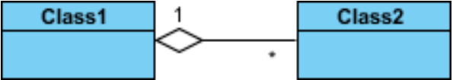
Aggregation
It represents a “whole-part" relationship.
A solid line with an unfilled diamond at the association end connected to the class of composite.
Class2 is part of Class1.
Many instances (denoted by the *) of Class2 can be associated with Class1.
The child class can exist independently of its parent class.

Slide 16
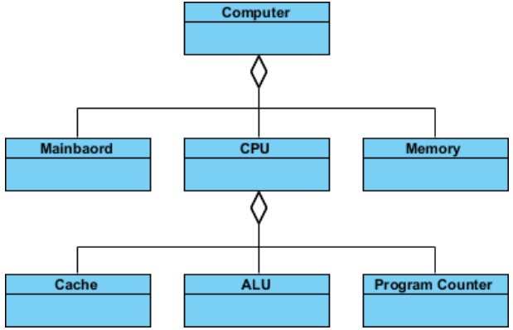
Aggregation

Slide 17
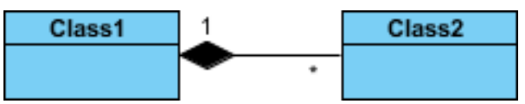
Composition
A strict type of aggregation where parts are destroyed when the whole is destroyed.
A solid line with a filled diamond at the association connected to the class of composite.
The child class cannot exist independently of the parent class.
Class2 cannot stand by itself.
Objects of Class2 live and die with Class1.

Slide 18
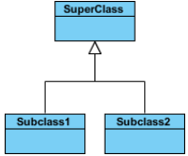
Inheritance (Generalization/Specialization)
Represents an "is-a" relationship.
A solid line with a hollow arrowhead that point from the child to the parent class.
SubClass1 and SubClass2 are Child class and Super Class is parent class.

Slide 19
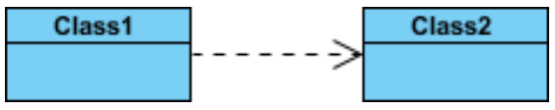
Dependency
Exists between two classes if changes to the definition of one may cause changes to the other (but not the other way around).
Class1 depends on Class2.
A dashed line with an open arrow.
It represents a more loosely coupled connection between classes.

Slide 20
Dependency
In an e-commerce application, a Cart class depends on a Product class because the Cart class uses the Product class as a parameter for an add operation.
In a class diagram, a dependency relationship points from the Cart class to the Product class. As the following figure illustrates, the Cart class is, therefore, the client, and the Product class is the supplier. This relationship indicates that a change to the Product class might require a change to the Cart class.
Cart
Product

Slide 21
Visibility of Class Attributes and Operations
In object-oriented design, there is a notation of visibility for attributes and operations.
UML identifies four types of visibility: public, protected, private, and package.
The +, -, # and ~ symbols before an attribute and operation name in a class denote the visibility of the attribute and operation.
+ for public (visible to all classes)
- for private (visible only within the class)
# for protected (visible to subclasses)
~ for package or default visibility (visible to classes in the same package)

Slide 22
Making Design Class Diagram
Identify all the classes participating in the software solution. This should be done by analyzing the interaction diagram.
Draw them in a class diagram
Duplicate the attributes from the associated concepts in the conceptual model
Add methods names by analyzing the interaction diagrams
Add type information to the attributes and methods
Add the associations necessary to support the required attribute visibility
Add navigability arrow to the association to indicate direction of attribute visibility
Add dependency relationship line to indicate non-attribute visibility

Slide 23
Identify all the classes
Main Success Scenario (or Basic Flow):
1. Customer arrives at a POS checkout with goods and/or services to purchase.
2. Cashier starts a new sale.
3. Cashier enters item identifier in the register.
4. System records sale line item and presents item description, price, and running total. Price calculated from a set of price rules.
5. Cashier repeats steps 2-3 until indicates done.
6. System presents total with taxes calculated.
7. Cashier tells Customer the total and asks for payment.

Slide 24
Identify all the classes
Register
Sale
ProductCatalog
Store
SalesLineItem
ProductDescription
Payment

Slide 25
Draw them in a class diagram
Register
ProductCatalog
ProductDescription
Payment
Store
Sale
SaleLineItem

Slide 26
Duplicate attributes from domain model
Register
ProductCatalog
ProductDescription
Payment
description
price
itemID
amount
Store
Sale
SaleLineItem
address
name
date
isComplete
quantity

Slide 27
Add methods names
Register
ProductCatalog
ProductDescription
Payment
description
price
itemID
amount
getSpecification()
endSale()
enterItem()
makePayment()
Sale
SaleLineItem
Store
datetime
isComplete
quantity
address name
becomeComplete() makeLineItem(…) getTotal()
getSubTotal()
addSale()

Slide 28
Add type information and visibility
Register
ProductCatalog
+getDescription(id : itemID) : +ProductDescription
+endSale()
+enterItem(id : itemID, qty : integer)
+makePayment(cashTendered : money)
ProductDescription
SaleLineItem
Payment
-description : text
-price : money
-itemID : itemID
-quantity : integer
-amount : money
+getSubTotal() : money

Slide 29
Add type information
Store
Sale
-address : string -name: text
-date: DateTime
-isComplete:Boolean
+addSale(s: Sale)
+becomeComplete() +makeLineItem(desc : ProductDescription, qty : integer) +getTotal() : Money

Slide 30

Never break attribute or operations line
Register
Sale
-date: DateTime
-isComplete:Boolean
+endSale()
+enterItem(id : itemID, qty : integer)
+makePayment(cashTendered : money)
+becomeComplete() +makeLineItem(desc : ProductDescription, qty : integer) +getTotal() : Money

Slide 31
Add associations and navigability
Register
Sale
-date: DateTime
-isComplete:Boolean
1
captures
+endSale()
+enterItem(…)
+makePayment(…)
1
+becomeComplete() +makeLineItem(…) +getTotal() : Money

Slide 32
Add associations and navigability
Store
uses
1
ProductDescription
1
1
contains
1
ProductCatalog
1
1..*
1
1
describes
looks-in
keeps
1
SaleLineItem
1..*
*
1
Register
Sale
1
contains
captures
1
1
1
Payment
logs
*
paid-by
1

Slide 33
Add dependency relationship (optional)
Store
uses
1
ProductDescription
1
1
contains
1
ProductCatalog
1
1..*
1
1
describes
looks-in
keeps
1
SaleLineItem
1..*
*
1
Register
Sale
1
contains
captures
1
1
1
Payment
logs
*
paid-by
1

Slide 34
Practical
Customers can open Savings, Current, or Loan Accounts based on their minimum balance and interest rate. These accounts can add as many customers as possible. All these accounts can deposit money, withdraw money, and add or remove loans. Accounts belong to their specific branch and city where the Bank can manage its branches. Prepare a class diagram representing the above scenario.
Notes:
Bank (name, location, code, manageBranch) 1 composition * Branch(branchCode, city, addAccount, remove account) 1 aggregation 0..* Account(Acc_no, balance, deposit, withdraw, addloan, remove loan) inheritance Loan(loanno, amount, type, addCustomer, getEMI) 0…* Saving(minimum balance interest rate, manageCustomer)0…1 Current(interest rate, opening date, addCustomer) 0…1 is used by 1 Customer(custId, name, address).

Slide 35
Practical
Classes
Bank
Branch
Account
Loan Account, Saving Account, Saving Account
Customer
Notes:
Bank (name, location, code, manageBranch) 1 composition * Branch(branchCode, city, addAccount, remove account) 1 aggregation 0..* Account(Acc_no, balance, deposit, withdraw, addloan, remove loan) inheritance Loan(loanno, amount, type, addCustomer, getEMI) 0…* Saving(minimum balance interest rate, manageCustomer)0…1 Current(interest rate, opening date, addCustomer) 0…1 is used by 1 Customer(custId, name, address).

Slide 37
PREVIEW FOR LECTURE 15
IMPLEMENTATION

